Slide 1

PERSONALIZED ACADEMIC INTERVENTIONS
USING ADAPTIVE AND EXPLAINABLE AI: MULTI-
MODAL LEARNING ANALYTICS FRAMEWORK
Final Year Research PP2 Presentation
Project ID - 25-26J-172
Team Members
Ravisanka U V P - IT22354792 (Component 01)
Disanayaka S T - IT22370228 (Component 02)
Nimanji D.L.K - IT22365750 (Component 03)
Perera I A T D - IT22902702 (Component 04)
06/01/2026
1

Slide 2


Slide 3
Target Users & Beneficiaries
Primary Users
Students
Understand which lessons they struggle with
Get personalized recommendations before exams
Receive instant help through chatbot assistance
Secondary Users
Lecturers
Identify struggling and disengaged students early
Monitor lesson-level difficulties
Reduce manual monitoring effort
Institutions
Improve student retention and success rates
Enable data-driven academic decision-making

Slide 4
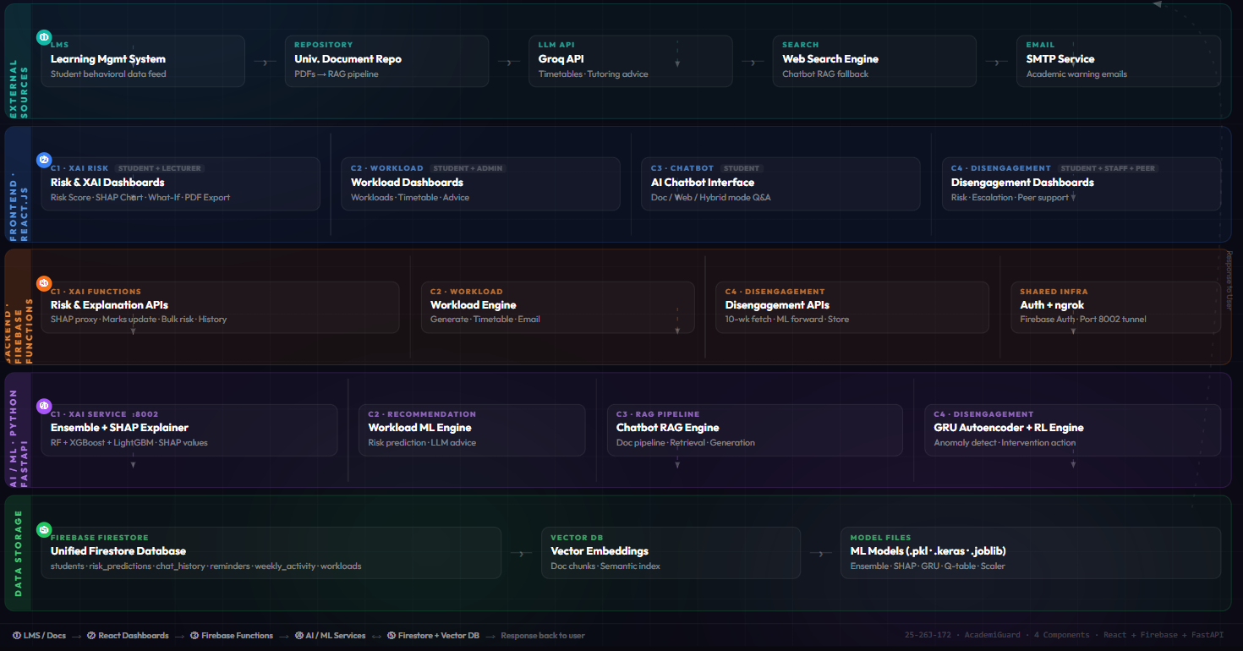
System Architecture

Slide 5

PERSONALIZED ACADEMIC INTERVENTIONS USING ADAPTIVE AND EXPLAINABLE AI: MULTI- MODAL LEARNING ANALYTICS FRAMEWORK
Investment / Cost
Developement: 1,000,000 LKR annually for machine learning, AI and implementation.
Infrastructure: With government “Cloud First” policy promoting cloud adoption (Apache Kafka, AWS, Azure) estimated at roughly 20,000 to 40,000 LKR/month for compute and storage at startup scale.
Cost Recovery
Subscription model targeting educational institutions charging 1500 LKR per student
Customization and training packages billed separately, e.g., 500,000–1,000,000 LKR per contract.
Government grants and educational funding programs may subsidize early adoption.
Potential to scale with private university and vocational sector clients at premium pricing.
Target Market
Sri Lanka has over 4.5 million students enrolled in Government and private schools.
Growing market focus on Higher Education with 23% tertiary enrollment.
Customer Profiles
Public and private universities, schools, technical/vocational institutes.
Government education departments and school management bodies.
NGOs and international development agencies engaged in education improvement.

Slide 6
Thank You

